Slide 1
Good morning Mr President
You are a news reporter and your editor is sending you to The White House to interview the new President Roosevelt. Prepare a list of questions you will ask the president about his plans to help America out of The Depression.
Deeper questions
 | is/are/ does | was/were/ did | can | would/ could | will | might
What? | The situation at the start of Roosevelt’s presidency
Where? | Investors who bought stocks and shares had lost their money.
When? | In 1932, more than 10 million Americans were unemployed.
Which? | There were severe food shortages after droughts in farming areas.
Who? | The banks were calling in loans they had made to companies and individuals.
Why? | Demand for manufactured goods had fallen.
How? | Roosevelt had declared a four-day bank holiday.
Deeper thinking

Slide 2
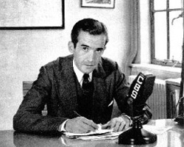
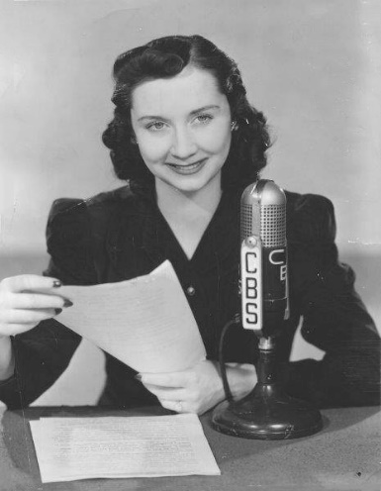
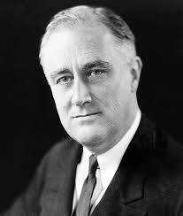
Good morning, Mr President!
You have been invited to The White House to interview
President Franklin D. Roosevelt.
Here is your script. Please feel free to press the president on any point he does not make clear.
How might you tackle the depression when you have barely any money?
How will you restore people’s confidence in banks and stock markets?
How might you secure enough money to improve all 50 states?
How might America get back into international trade?
How will you help Americans out of Hoovervilles and into homes?
How will you restore the unemployment rates to what they were before the crash?
How much help will you need from other people, including the former president?

